Slide 1
Movie Library Project
Creators:
Aryal Sagar
Haavisto Heli
Ivankina Elena
Ubozhenko Iolanta

Slide 2
Step 1 - Idea
We have chosen to make a movie library, because:
To work with API
Possible to finish in 3 days

Slide 3
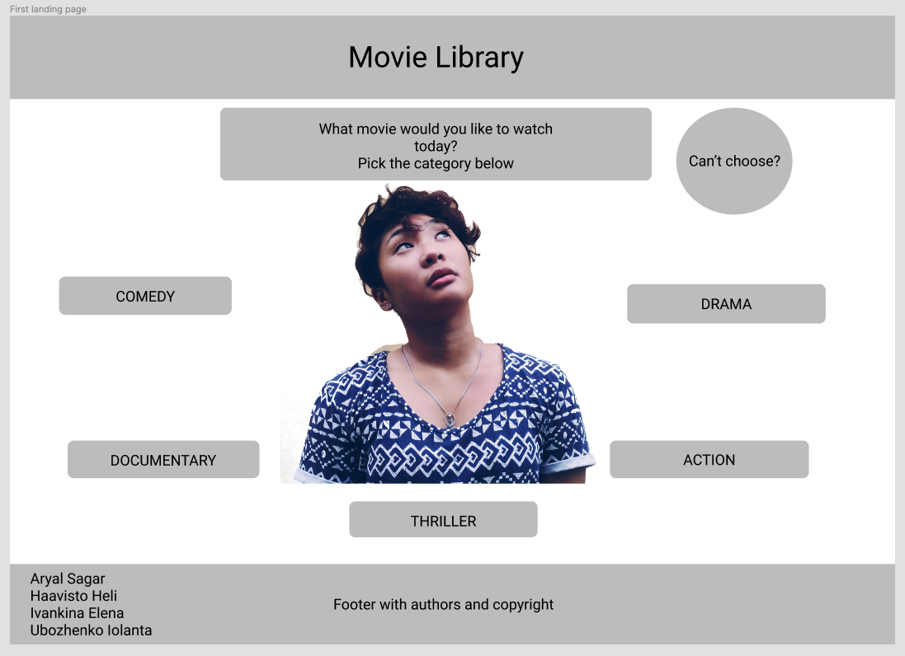
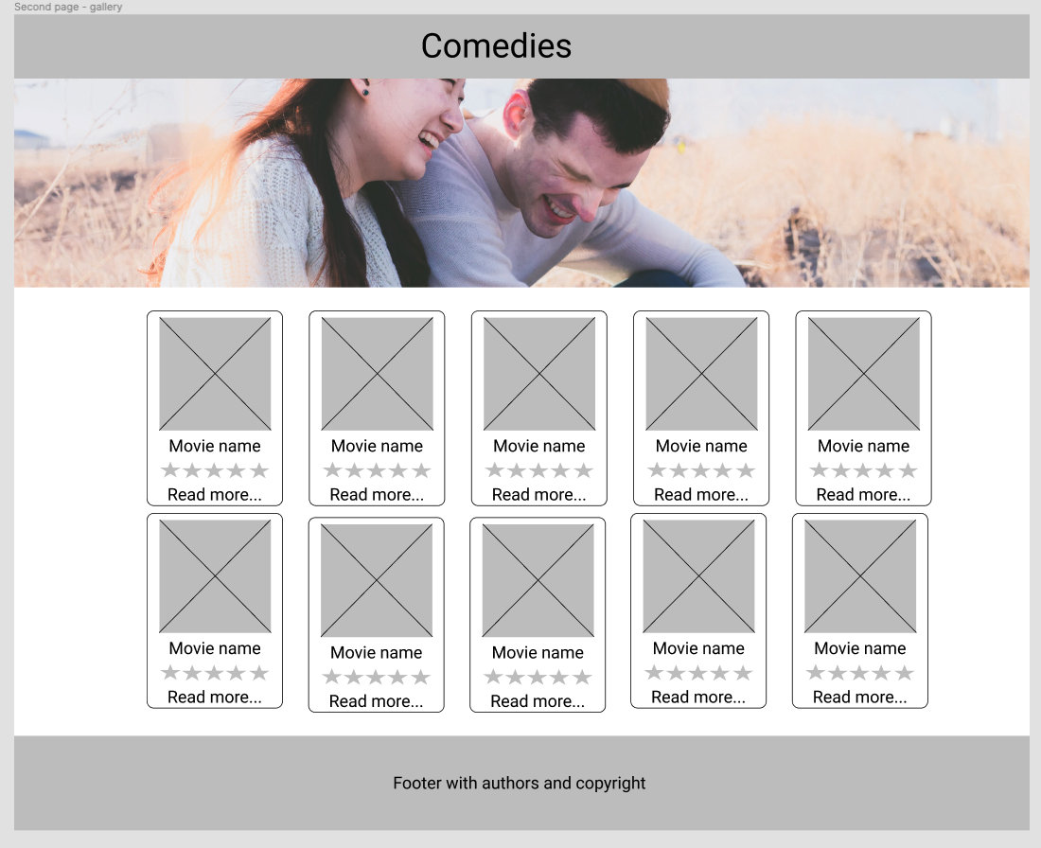
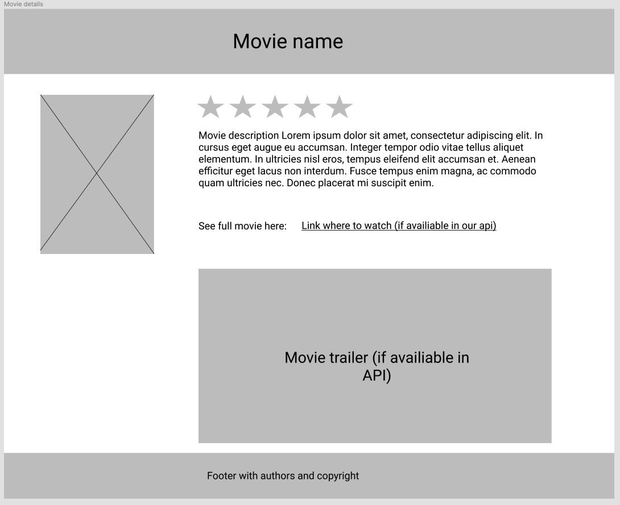
Step 2 – Wireframe in Figma

Slide 4
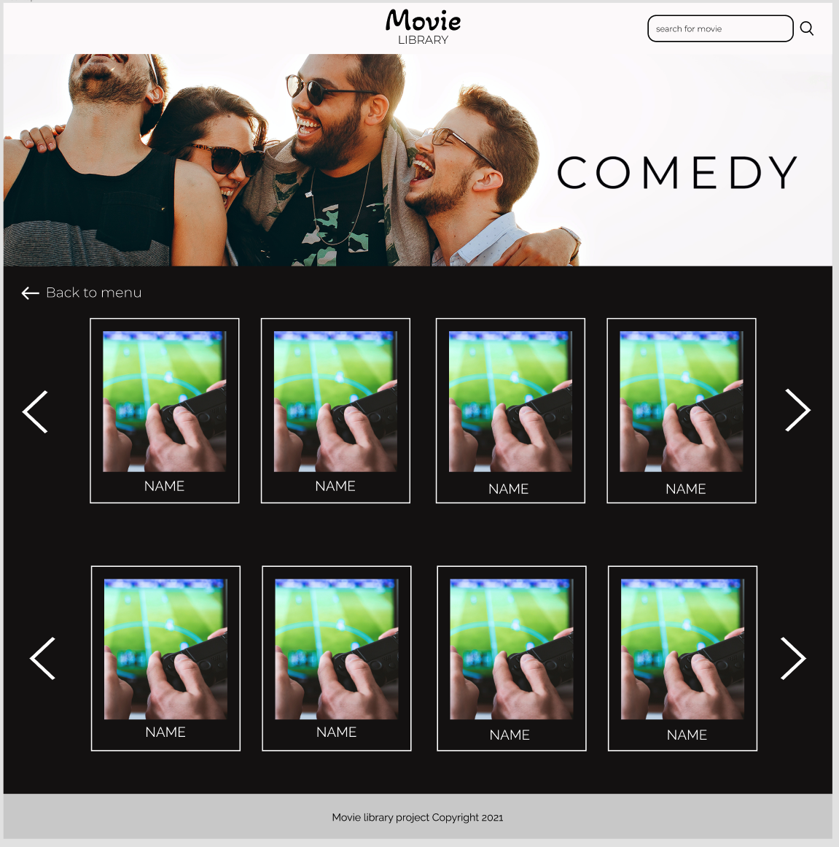
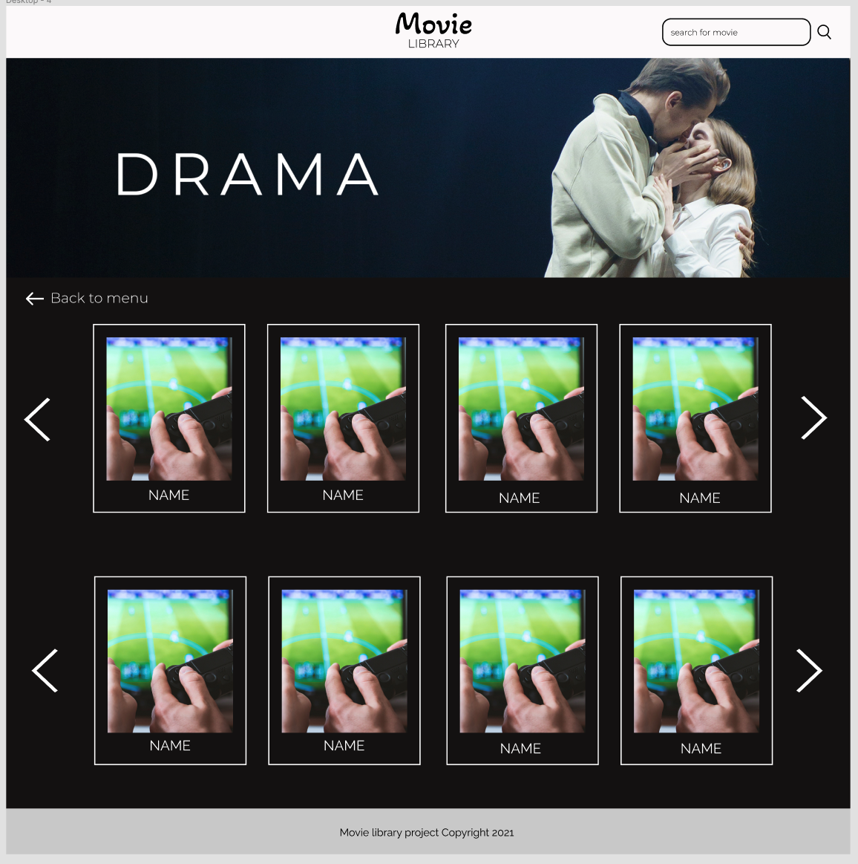
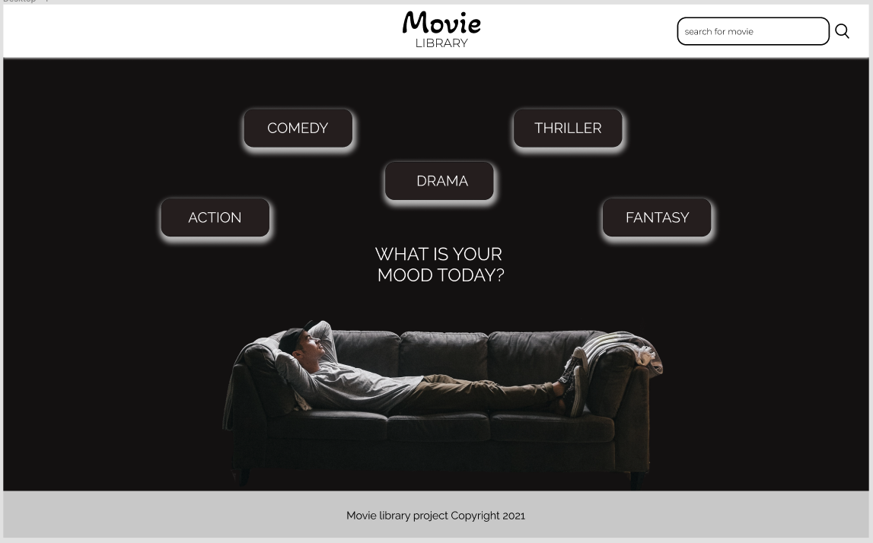
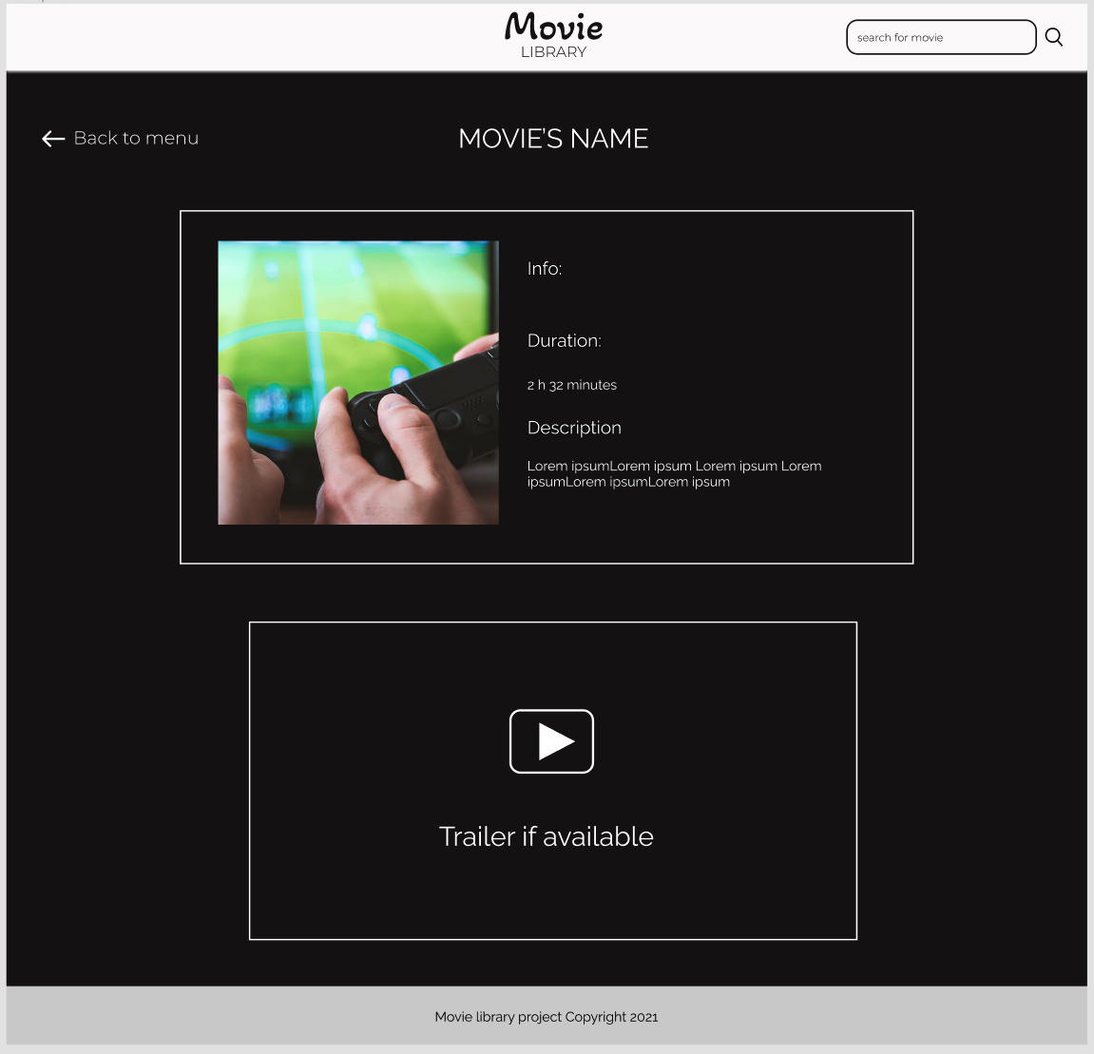
Step 3 – Prototype in Figma
https://www.figma.com/proto/XtZbg2hE4DuNm0eN4Gc7FV/Movie-library-prototype?node-id=1%3A2&scaling=min-zoom

Slide 5
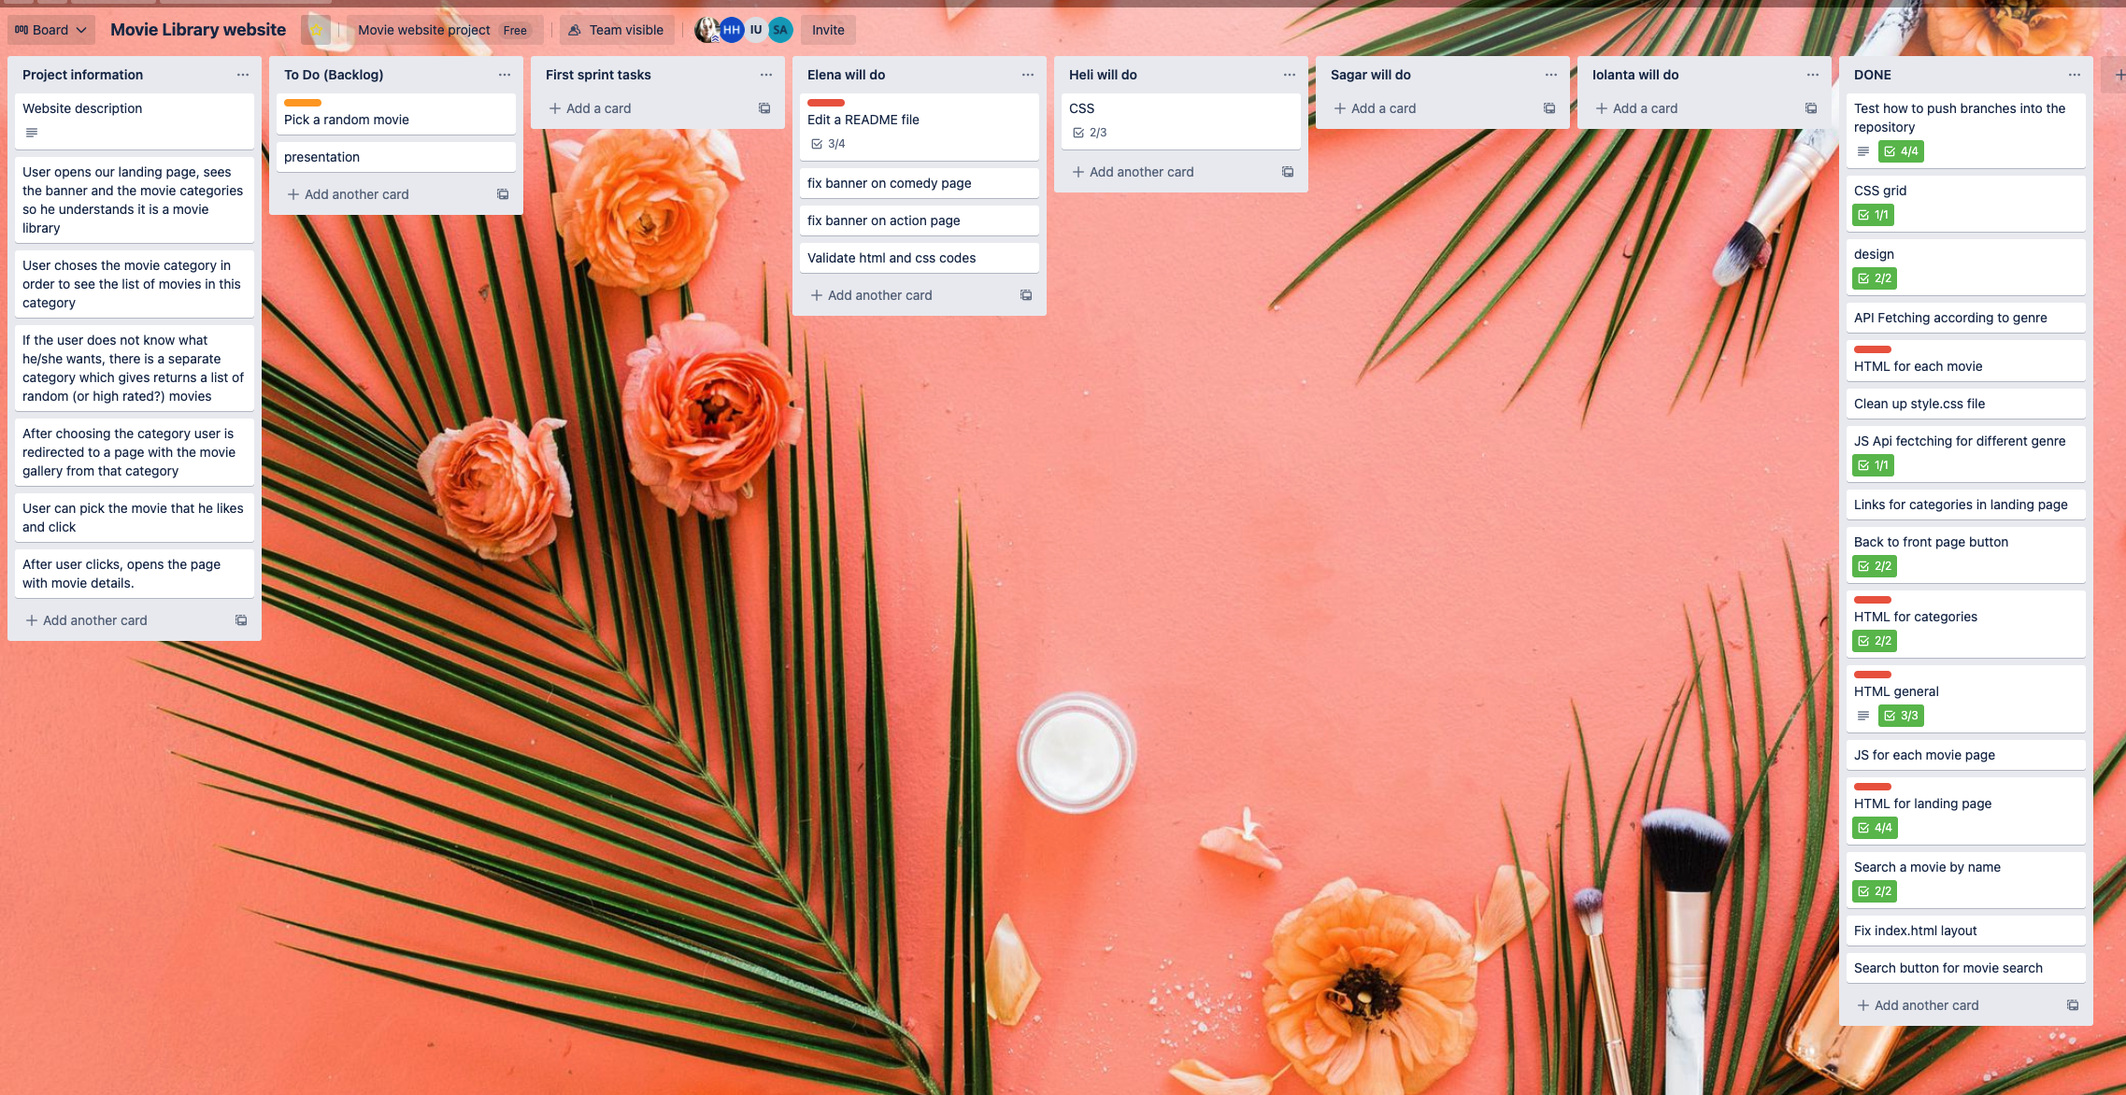
Step 4 – Coding and collaborating
GitHub for sharing and merging our code
Teams for confcalls and chat
Trello for tracking our tasks

